Slide 1
Data Analysis, Interpretation and Presentation
Samia Arshad

Slide 2
Introduction
Qualitative and quantitative
Mix methods
Ratio, averages, percentages
Data cleansing
Investigator beliefs and biases
Claims that go beyond data
Support conclusion by results

Slide 3
Qualitative Data
Qualitative data is in the form of words and images, and it includes descriptions, quotes from interviewees, and photos.
Qualitative analysis focuses on the nature of something and can be represented by themes, patterns, and stories.
For example, in describing the same population, a qualitative analysis might conclude that the average person is tall, thin, and middle-aged.

Slide 4
Quantitative Data
Quantitative data is in the form of numbers, or data that can easily be translated into numbers.
Quantitative analysis uses numerical methods to ascertain the magnitude, amount, or size of something (the attributes, behavior, or strength of opinion of the participants).
For example, in describing a population, a quantitative analysis might conclude that the average person is 5 feet 11 inches tall, weighs 180 pounds, and is 45 years old.

Slide 5
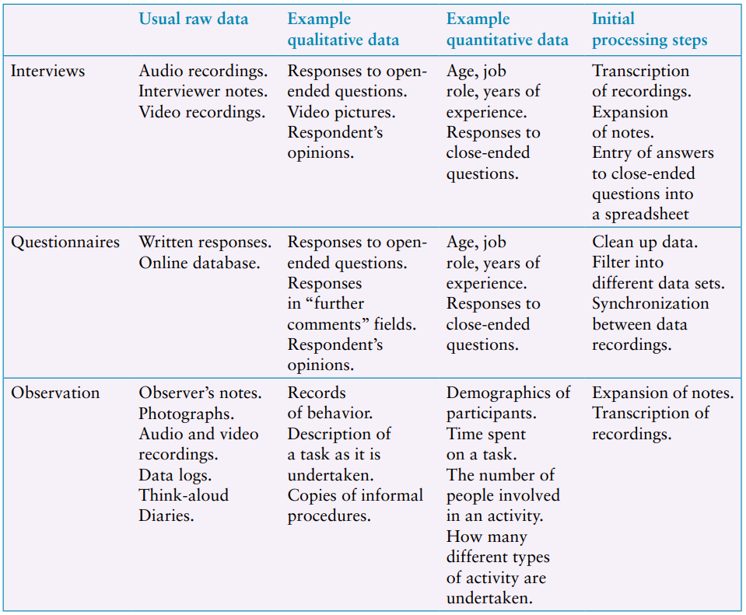
1st Step in Analyzing Data

Slide 6
Quantitative Analysis
Percentages
Percentages are useful for standardizing the data, particularly to compare two or more large sets of responses.
Averages
Mean refers to the commonly understood interpretation of average
Median is the middle value of the data when the numbers are ranked.
Mode is the most commonly occurring number

Slide 7

How Question Design Affects Data Analysis
Example : http://memorymirror.com/

Slide 8
How Question Design Affects Data Analysis
Questions: “How do you feel about this new app?”
Responses to this will be varied and may include that it is cool, impressive, realistic, clunky, technically complex, and so on.
Alternative Question: “In your experience, are virtual try-on holographs realistic, clunky, or distorted?”
This clearly reduces the number of options and the responses would be recorded as “realistic,” “clunky,” or “distorted.”

Slide 9
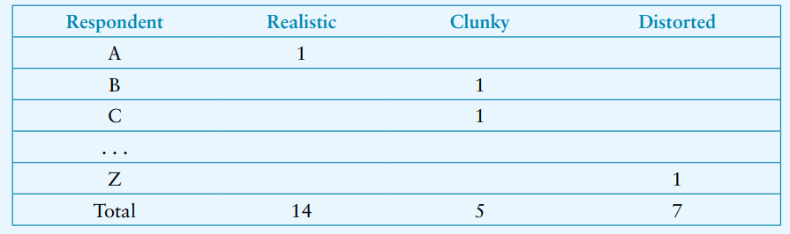
How Question Design Affects Data Analysis
Simple table, initial analysis of this data might look like the following:
14 out of 26(54%) thinks virtual try On holograph is realistic

Slide 10
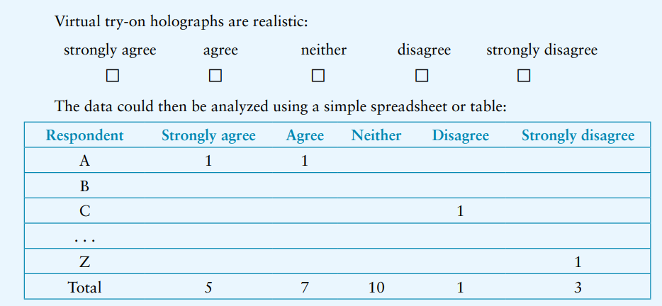
How Question Design Affects Data Analysis
Another alternative that might be used in a questionnaire is to phrase the question in terms of a Likert scale.

Slide 11
Basic Tools for Collation and Analysis
Excel and Google Sheets
offers a variety of numerical manipulations and graphical representations.
T-tests and A/B testing tools
for performing specific statistical tests

Slide 12
Outliers
Outliers : values that are significantly different from the majority, and hence not common.
Outliers are usually removed from the main data set because they distort the general patterns.
However, outliers may also be interesting cases to investigate further in case there are special circumstances surrounding those users and their session.

Slide 13
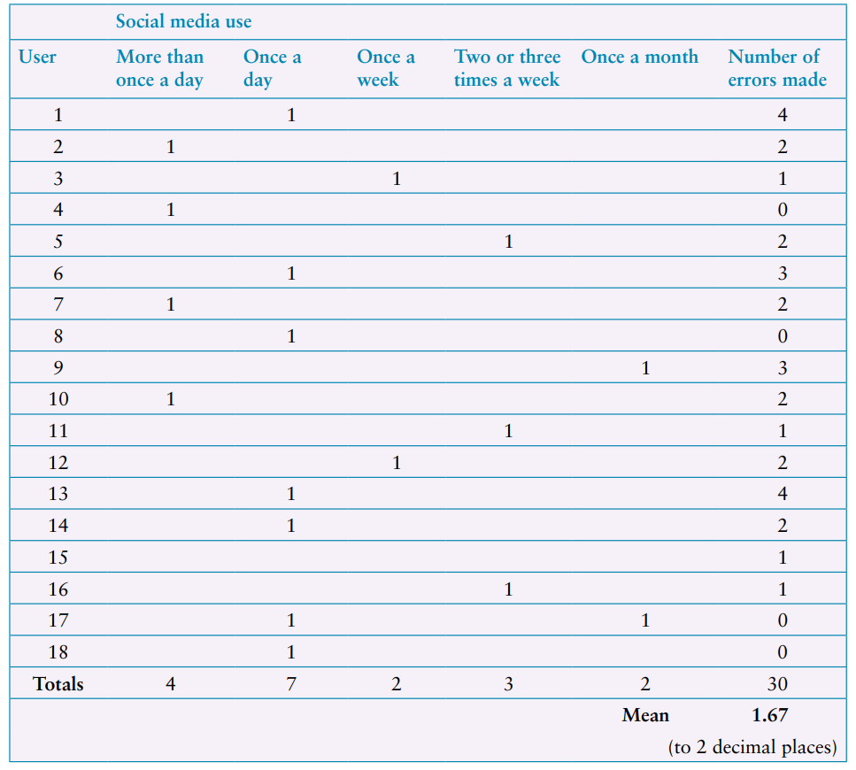
Presentations
Example: Data gathered during a study of a photo sharing app

Slide 14
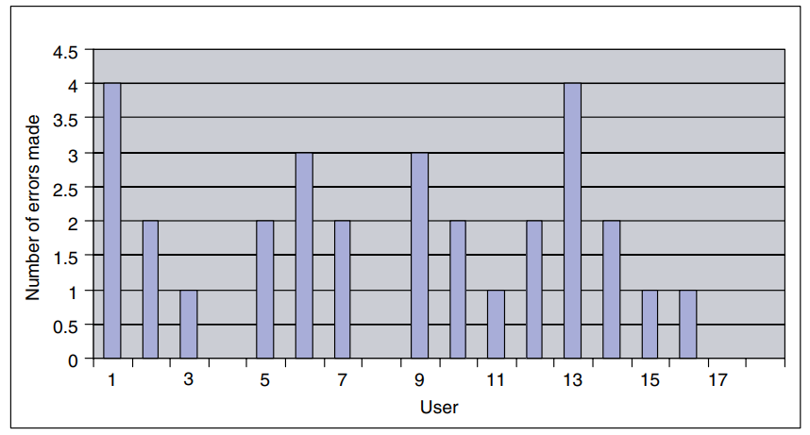
Presentations

Slide 15
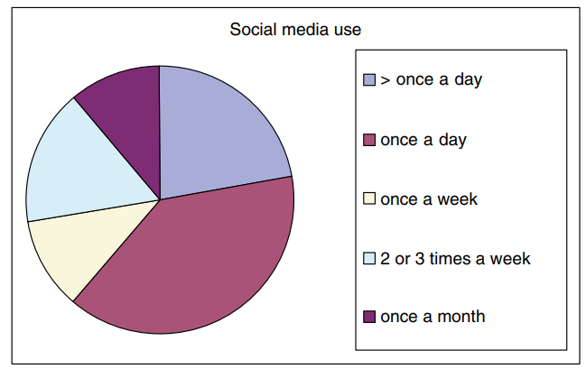
Presentation

Slide 16
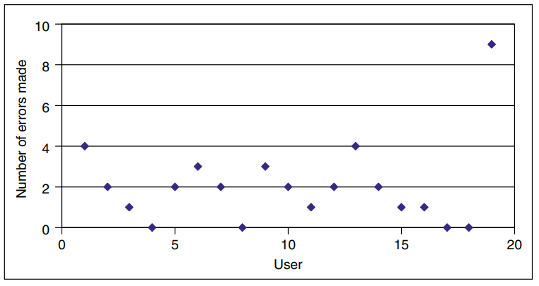
Presentation
Using a scatter diagram helps to identify outliers in your data quite quickly

Slide 17
Example 1
The data in the following table represents the time taken for a group of users to select and buy an item from an online shopping website
User | A | B | C | D | E | F | G | H | I | J | K | L | M | N | O | P | Q | R | S
Time | 15 | 10 | 12 | 10 | 14 | 13 | 11 | 18 | 14 | 17 | 20 | 15 | 18 | 24 | 12 | 16 | 18 | 20 | 26

Slide 18
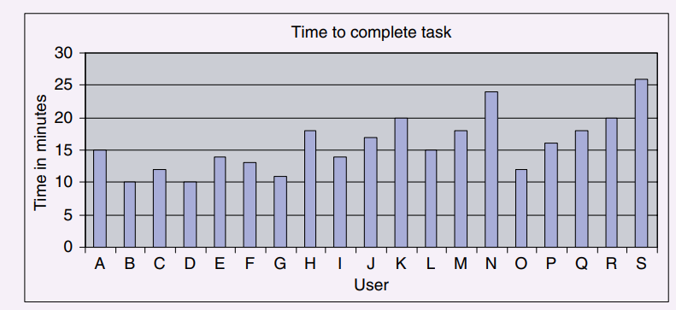
Example 1 – Bar Graph

Slide 19
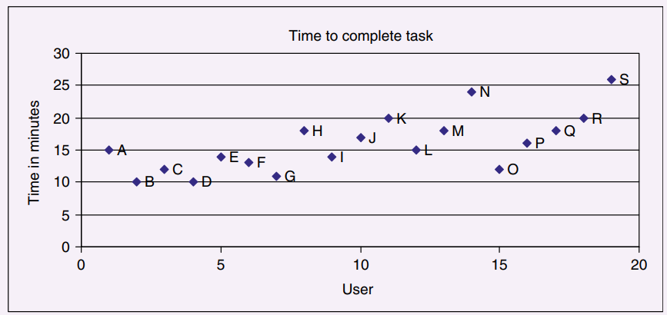
Example 1 – Scatter Diagram

Slide 20
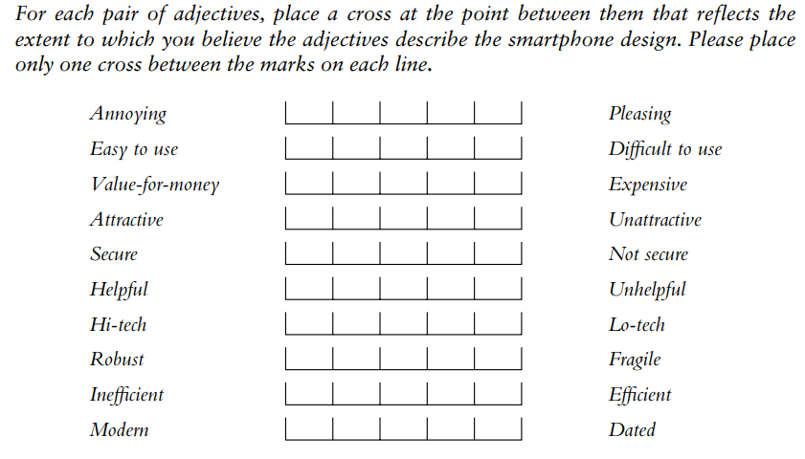
Example 2
The following question was asked in a questionnaire to evaluate two different smartphone designs:

Slide 21
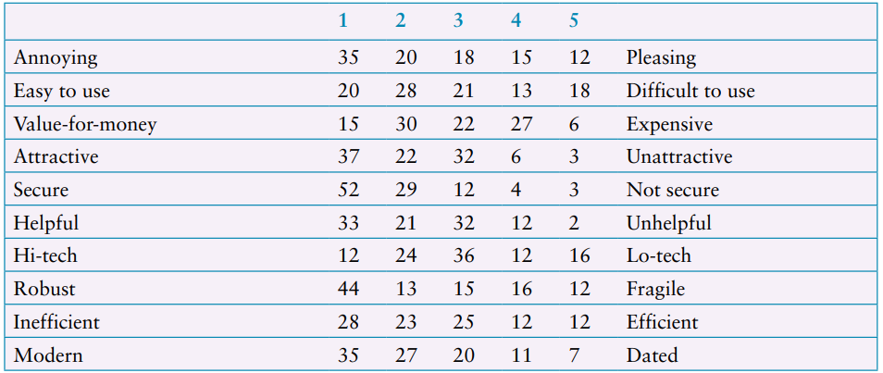
Example 2 – Phone 1

Slide 22
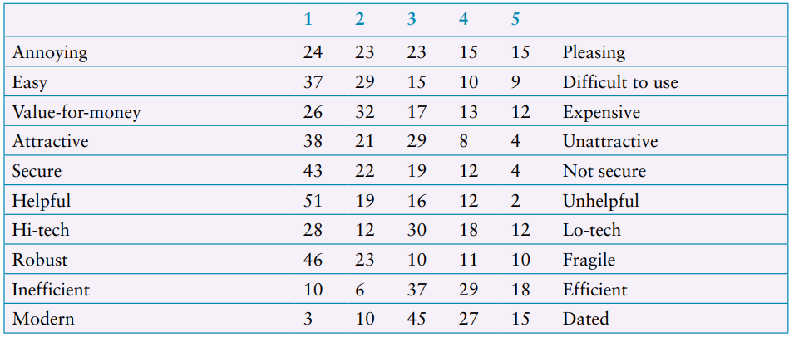
Example 2 – Phone 2

Slide 23
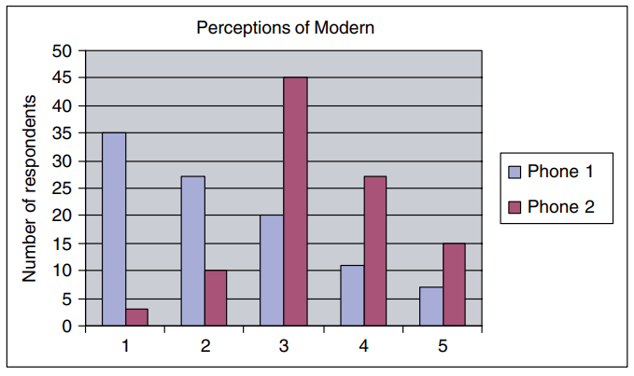
Example 2 – Bar Graph
A graphical comparison of two smartphone designs according to whether they are perceived as modern or dated.

Slide 24
Qualitative Analysis
Gain an overall impression of the data and to start looking for interesting features, topics, repeated observations, or things that stands out.
It is important to confirm and re-confirm findings to make sure that initial impressions don’t bias analysis.

Slide 25
Qualitative Analysis
Three basic approaches to qualitative analysis
identifying themes
categorizing data
analyzing critical incidents
Critical incident analysis is a way to isolate subsets of data for more detailed analysis, perhaps by identifying themes or applying categories.

Slide 26
Identify Themes
Theme
is something important about the data in relation to the study goal.
Represents a particular topic or feature found in the data set
Thematic Analysis
widely used analytical technique that aims to identify, analyze, and report patterns in the data.

Slide 27
Thematic Analysis
Inductive Analysis
Identify themes
Performed iteratively
Determine meaningful code that are orthogonal
Decide appropriate granularity

Slide 28
Thematic Analysis
Deductive Analysis
Categorize data
Apply build themes to new data
Performed iteratively

Slide 29
General Steps
Initial pass to look for themes
Look for more systematic themes to confirm and disconfirm the initial impression
Check consistency
Refined themes

Slide 30

Affinity Diagrams
The approach seeks to organize individual ideas and insights into a hierarchy showing common structures and themes.
Notes are grouped
Groups emerged from the data
Diagram start from one note

Slide 31
Categorizing Data
In this procedure the analysis frame (the set of categories used) is chosen beforehand, based on the study goal.
In that case, analysis proceeds deductively. F

Slide 32
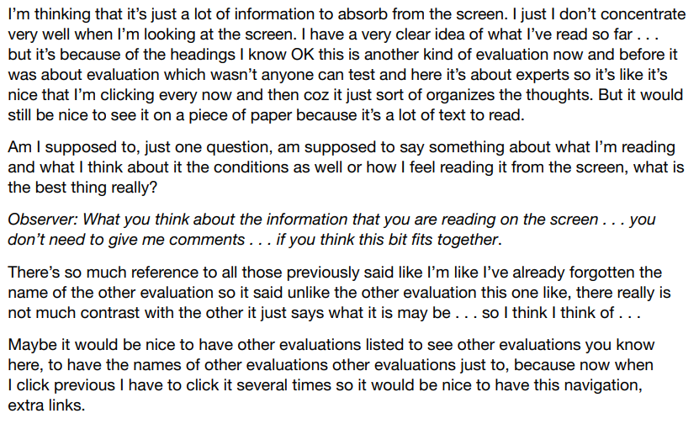
Example
Excerpt from a transcript of a think-aloud protocol when using an online educational environment.

Slide 33
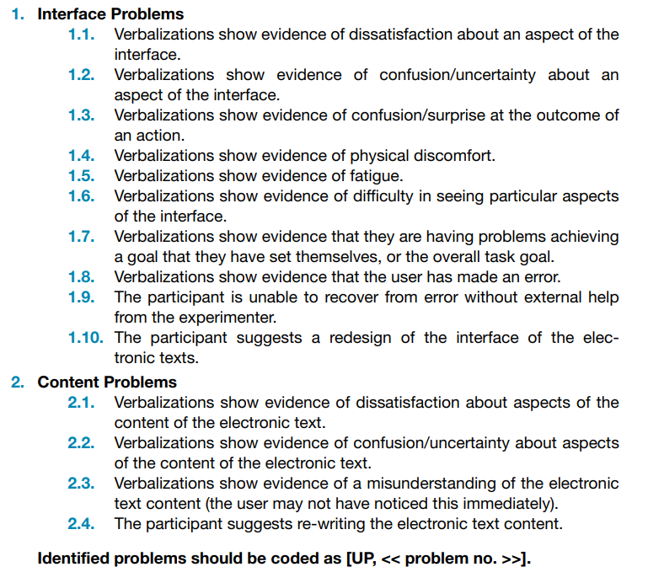
Example
Criteria for identifying usability problems from verbal protocol transcriptions

Slide 34
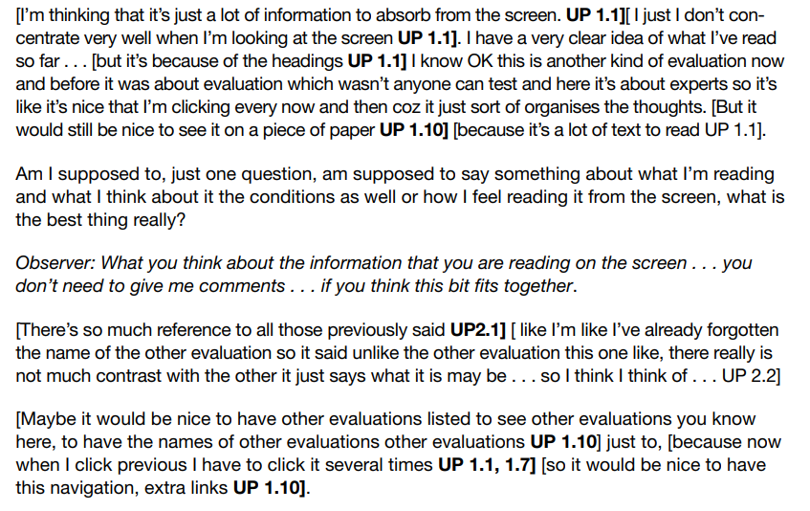
Example
The excerpt on Slide 31 coded using the categorization scheme on Slide 32

Slide 35
Critical Incident Analysis
Critical incident analysis is one approach that helps to identify significant subsets of the data for more detailed analysis.
It has two basic principles:
reporting facts regarding behavior is preferable to the collection of interpretations, ratings, and opinions based on general impressions.
reporting should be limited to those behaviors which, according to competent observers, make a significant contribution to the activity.

Slide 36
Critical Incident Analysis
In the interaction design context, the use of well-planned observation sessions satisfies the first principle.
The second principle refers to critical incidents, that is, incidents that are significant or pivotal to the activity being observed, in either a desirable or an undesirable way.

Slide 37
Analytical Frameworks
There are six different analytical frameworks
Can be used to analyze and interpret data from a qualitative study
Differ in terms of their granularity, that is, the level of detail involved.

Slide 38
Conversation analysis (CA)
Conversation analysis (CA) examines the semantics of a conversation in fine detail
The focus is on how a conversation is conducted
how conversations start and how turn-taking is structured
used to analyze interactions in a range of settings
has influenced designers’ understanding of users’ needs in their environments

Slide 39
Example
It can also be used to compare conversations that take place through different media
for example, face-to-face conversations versus those conducted through social media.
More recently, it has been used to analyze the conversations that take place with voice-assisted technologies and chatbots
Voice assistants (also called smart speakers), like Amazon Echo

Slide 40
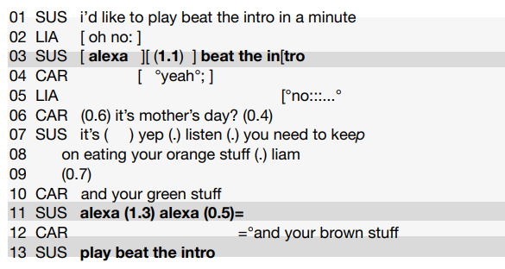
Example
An extract of the conversation between the family and Alexa, marked up for conversation analysis
Source: Porcheron et al. (2018), fragment 1. Reproduced with permission of ACM Publications

Slide 41
Discourse Analysis
Discourse analysis focuses on dialogue
the meaning of what is said and how words are used to convey meaning
Discourse analysis is strongly interpretive
pays great attention to context
and views language not only as reflecting psychological and social aspects but also as constructing them
discourse analysis provides a way of focusing on how people use language to construct versions of their words.e.g.fire
underlying philosophy of discourse analysis is similar to that of ethnography

Slide 42
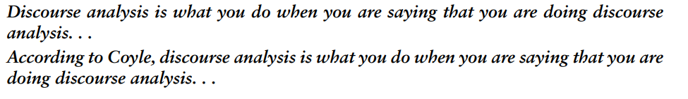
Example
Discourse analysis is useful
when trying to identify subtle
and implicit meaning in what people are writing about
what is trending
what is fake news, and so on

Slide 43
Content Analysis
Content analysis typically involves classifying the data into themes or categories and then studying the frequency of category occurrences
The technique can be used for any text
where “text” refers to a range of media including video, newspapers, advertisements, survey responses, images, sounds
It can be used to analyze any online content
including the text of tweets, links, animated gifs, videos, and images.
It considers wider context

Slide 44
Example
Mark Blythe and Paul Cairns (2009) analyzed 100 videos from a YouTube search by relevance for “iPhone 3G” using content analysis.
They categorized the videos into seven categories:
review, reportage, “unboxing,” demonstration, satire, advertisement, and vlog commentaries (such as, complaints about queues)

Slide 45
Interaction Analysis
Interaction analysis is a way of investigating and understanding the interactions of human beings with each other and objects in their environment.
It is based on video recordings
This technique focuses on both talk and nonverbal interactions with artifacts and technologies
Interaction analysis is an inductive process
interaction analysis is conducted collaboratively by a team of researchers

Slide 46
Example
Anna Xambo et al.’s (2013) study of how groups of musicians improvise and learn to play together when using a novel collaborative tabletop technology.
Video data was collected
Representative video extracts were repeatedly viewed and discussed by a team of researchers
These themes were categorized into whether they were musical, physical, or interface-related

Slide 47
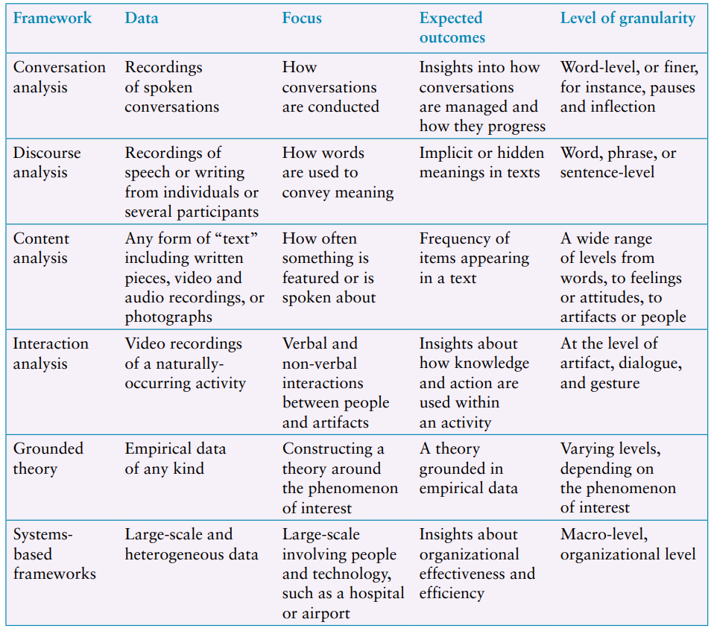
Which Kind of Analytic Framework to Use?
Overview of analytical frameworks used in interaction Design

Slide 48
Tools to Support Data Analysis
Nvivo
Nvivo supports the annotation and coding of data including PDF documents, photos, and video and audio files
Dedoose
Statistical Analysis Software (SAS) and Statistical Package for the Social Sciences (SPSS)
are popular quantitative analysis packages that support the use of statistical tests.

Slide 49
Interpreting and Presenting the Findings
There are different ways to present the findings.
Structured notations
Stories
Summarizing.
Choosing an appropriate way to present the findings of a study is as important as choosing the right analytical approach.

Slide 50
Structured Notations
Developed to analyze, capture, and present information for interaction design.
Follow a clear syntax and semantics
Developed to capture particular viewpoints
Use simple conventions for representing flows, breakdowns, individual roles
Unified Modeling Language (UML), have stricter and more precise syntax to be followed

Slide 51
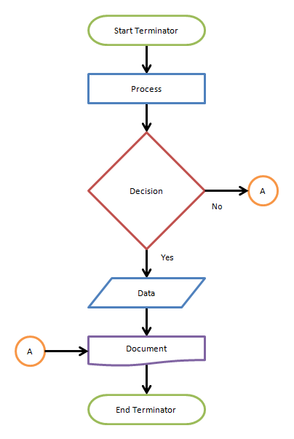
Example – Flow Chart

Slide 52
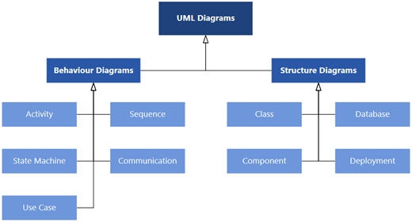
Example – UML

Slide 53
Stories – Narratives
Storytelling is an easy and intuitive approach for people to communicate ideas and experiences.
Storytelling may be employed in three different ways.
First, participants (such as interviewees, questionnaire respondents, and those you have observed) may have told stories of their own during data gathering
Second, stories (or narratives) based on observation, such as ethnographic field studies, may be employed for further data gathering.
Third, stories may be constructed from smaller snippets or repeated episodes that are found in the data.

Slide 54
Summarizing the Findings
Graphical representations
Demographics
Data excerpts
Videos
Diagrams
Tables
Rigorous notations
Workflows
Quotations

Slide 55
Conclusions
Qualitative and quantitative data
Basic quantitative analysis
Basic qualitative analysis
Analytic frameworks
Tools to support data
Interpreting and presenting findings

